Slide 1
Travel Advisor
Final Project - IronHack

Slide 2
Summary
Overview
01
02
03
Climate Change
Project
04
Testing
Notes:
So let’s talk about the project and test them. I just put some information about the climate change, because when we look for the temperature we can see, how this is changing over years

Slide 3
Overview
The project idea is Adviser your next travel based on your previous experiences, using a specific time to give you nice recommendations.
Notes:
The idea is give you some recommendations based on places that you have been before based on the weather conditions of this place.

Slide 4
–IPCC Climate Change
“It is indisputable that human activities are causing climate change, making extreme climate events, including heat waves, heavy rainfall, and droughts, more frequent and severe.”
Notes:
I put this just to heads up, after all I used the weather to clustering my recommendations, but is important to reminder everyone, that we have a crazy weather and Is the human activities that making many of this crassiness

Slide 5
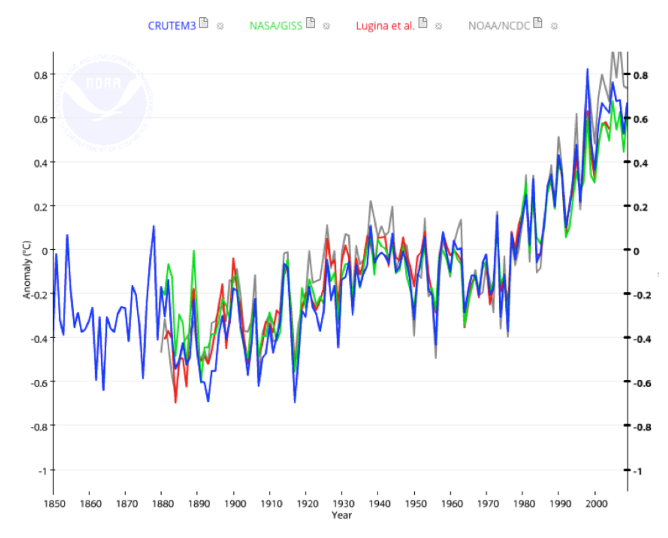
Climate Changes
It’s clear that weather stations on land show average air temperatures are rising, and as a result, the frequency and severity of droughts and heat waves are increasing..
Notes:
Just to see how increase the temperature in the last 20 years

Slide 6
About the Project
Dataset
API Skyscanner
Most Populated cities
Currencies of Countries
Languages
Request cheapest flights for cities on the recommendation
API Weather
Clustering
Request on API, weather information
Finding similarity on the weather

Slide 7
01
Problems
Almost 400 cities is on China and 100 in India.
Features in the weather is by day
Limit for 20 cities in the dataset.
Calculated the average for each features
Solution
02
Notes:
When I used the cities dataset, I noticed with 0 surprise that hundred in on china, and 1 hundred is on india, so I cut some cities, because we will have many similar custers. And to request the weather history with more features Idid by day, so I need to calculate the average for month.

Slide 8
WEATHER MAP
Your City
Mon
Tue
Wed
Thu
Fri
Sat
Sun

Slide 9
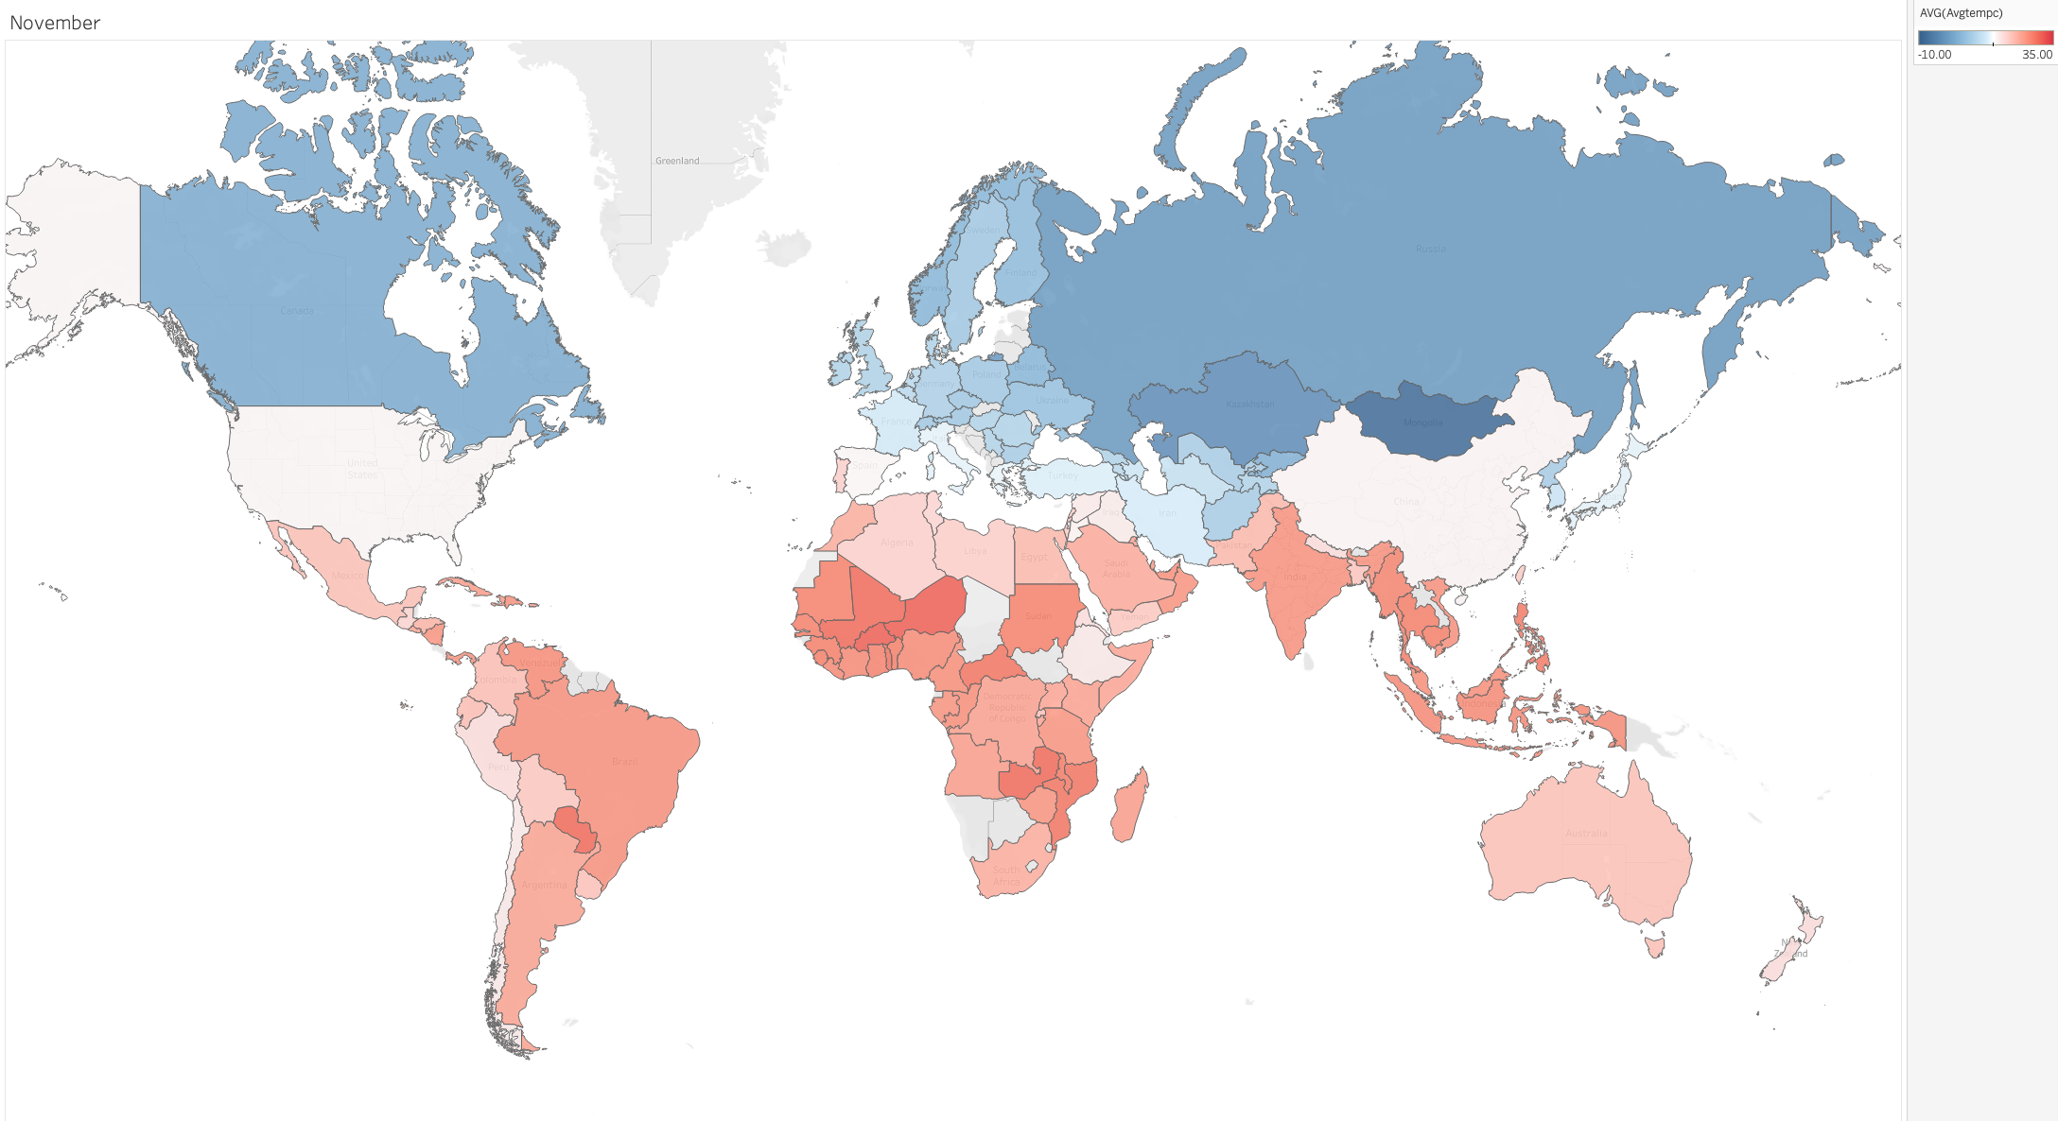
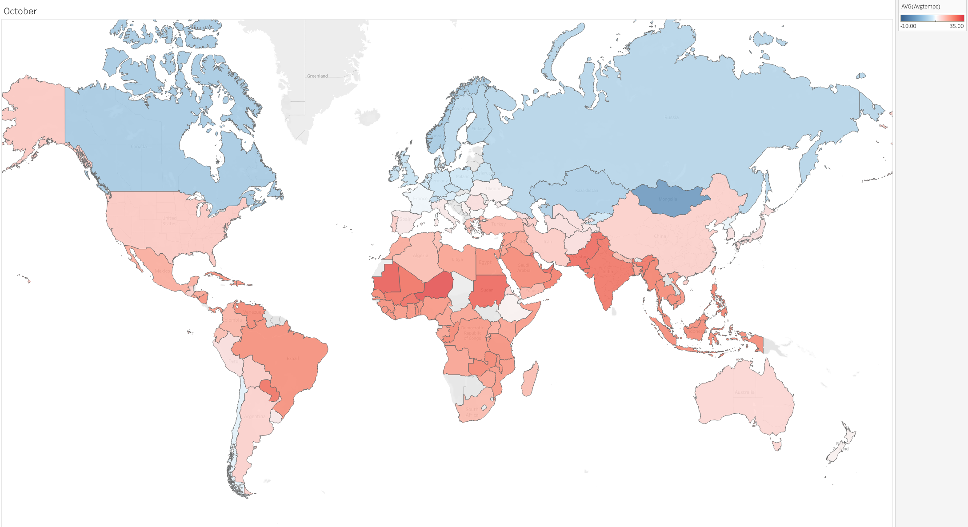
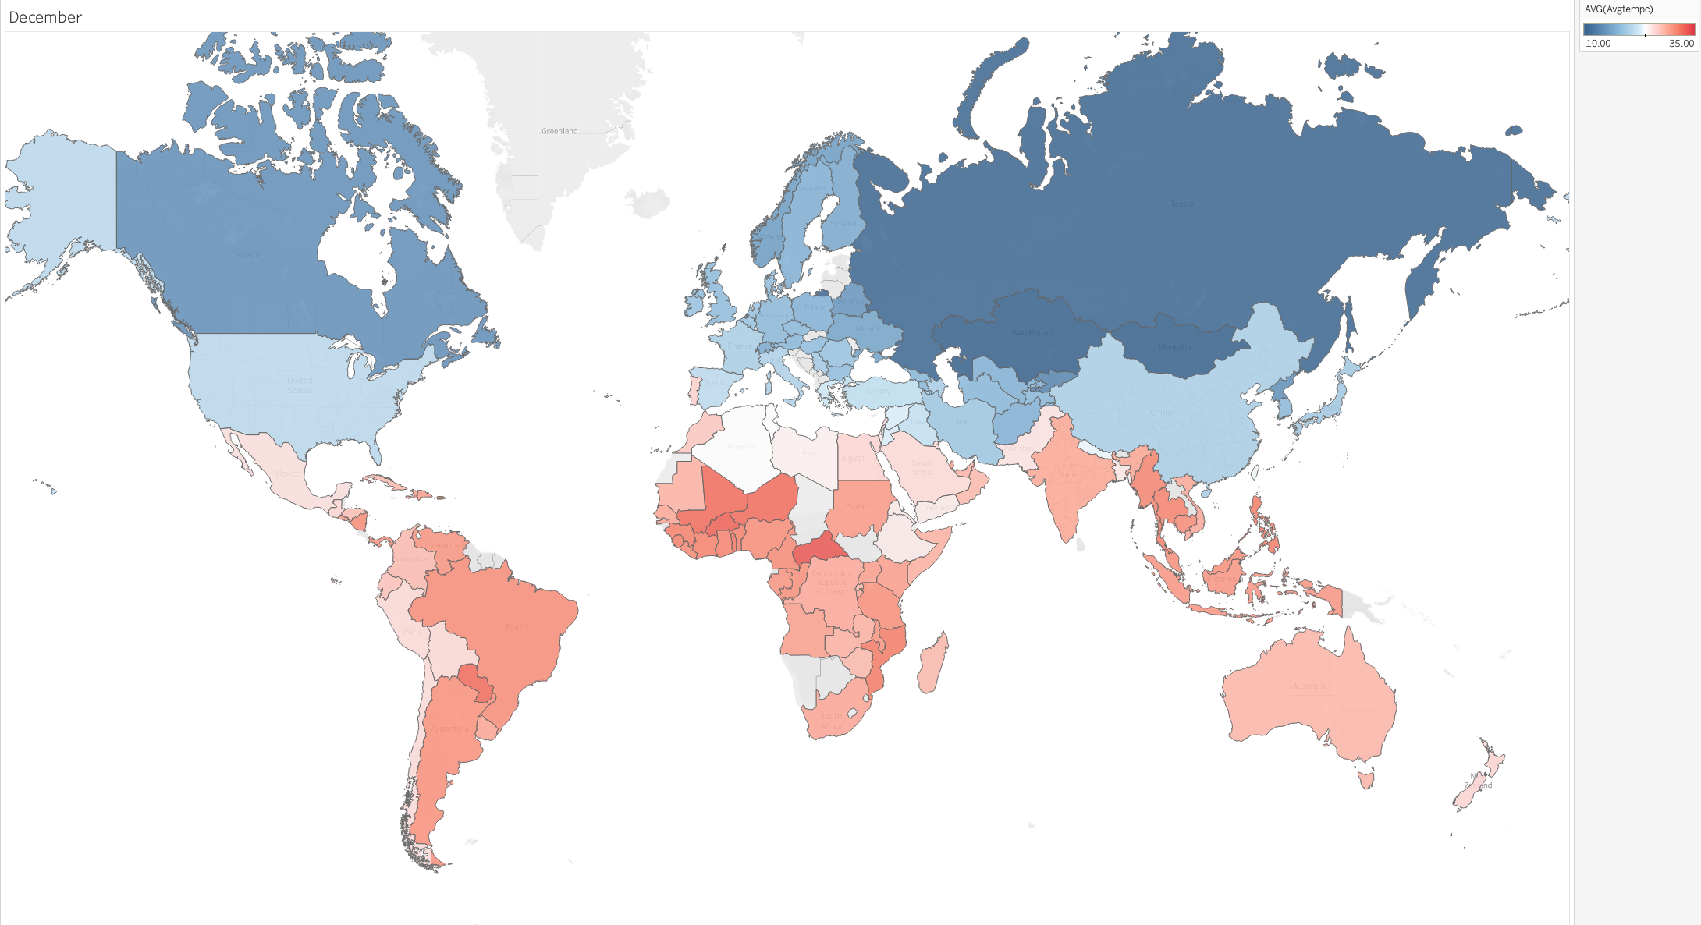
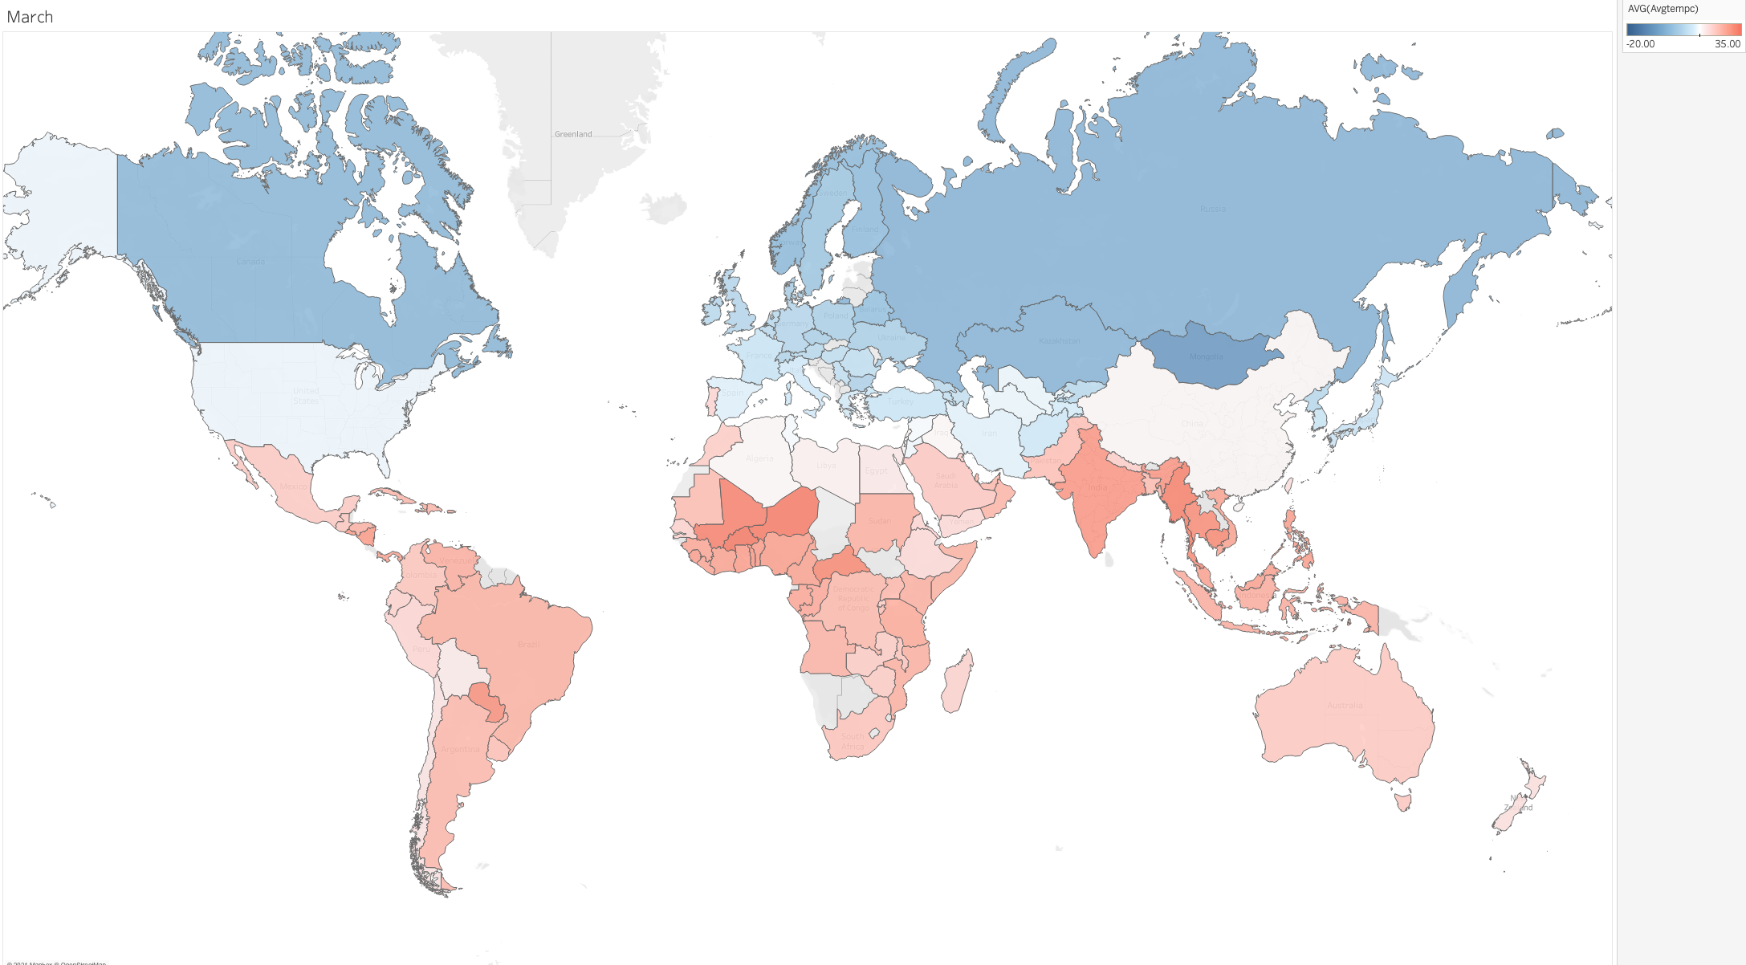
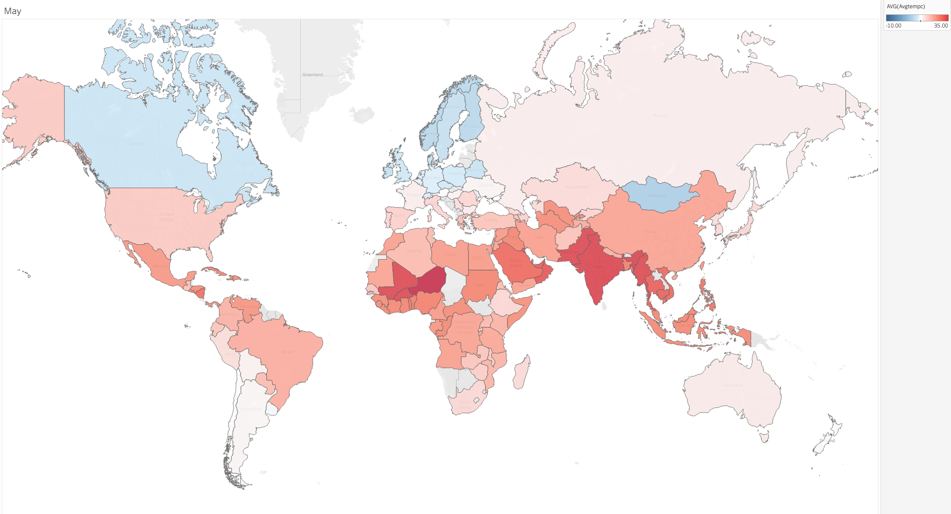
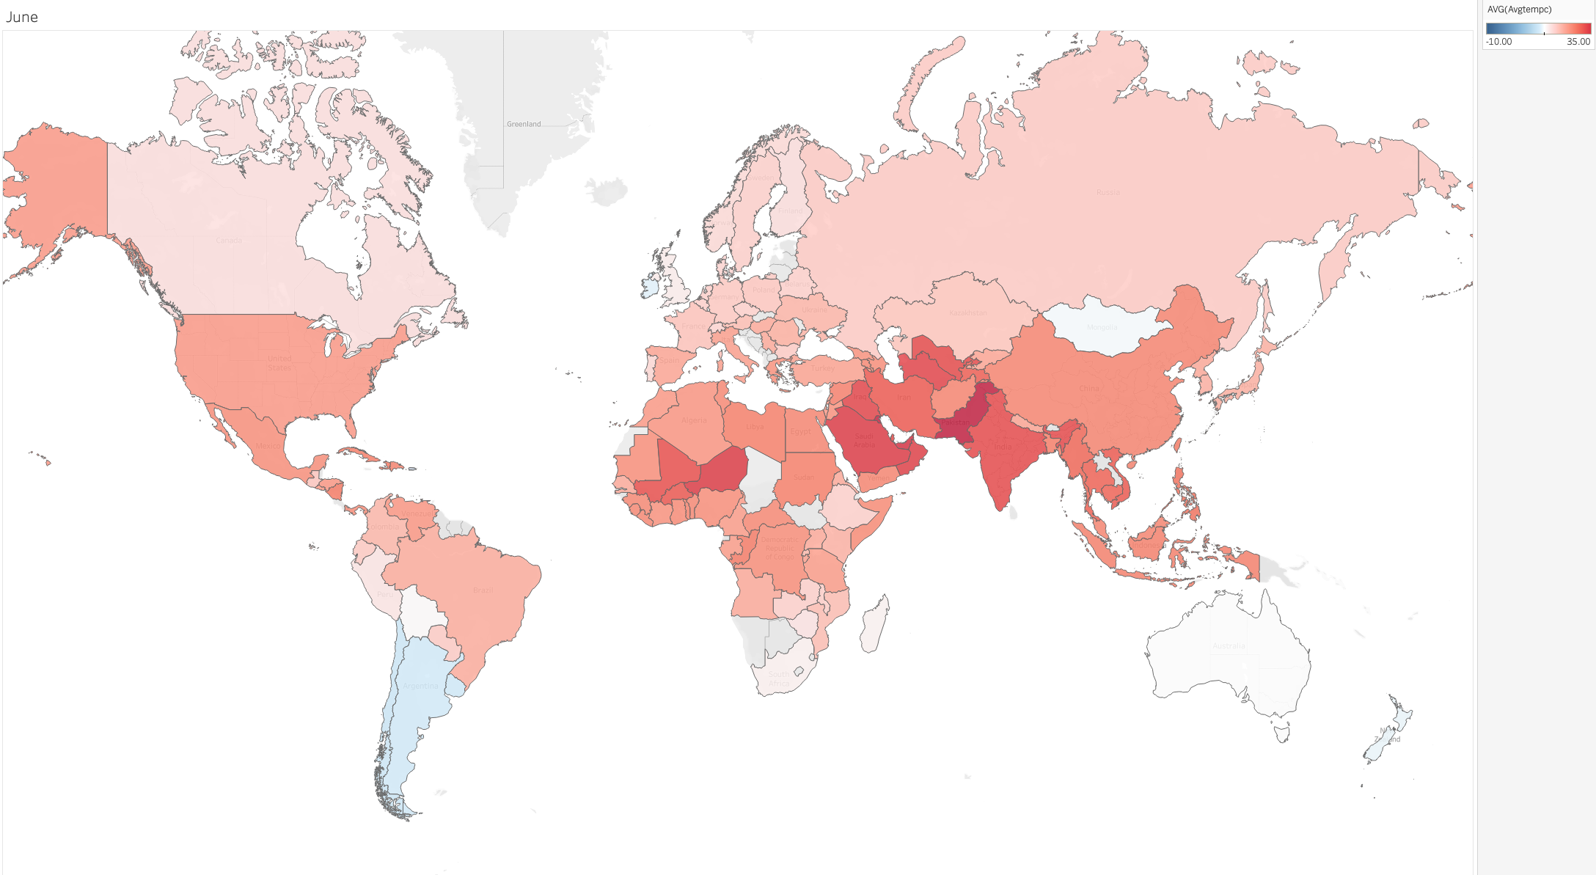
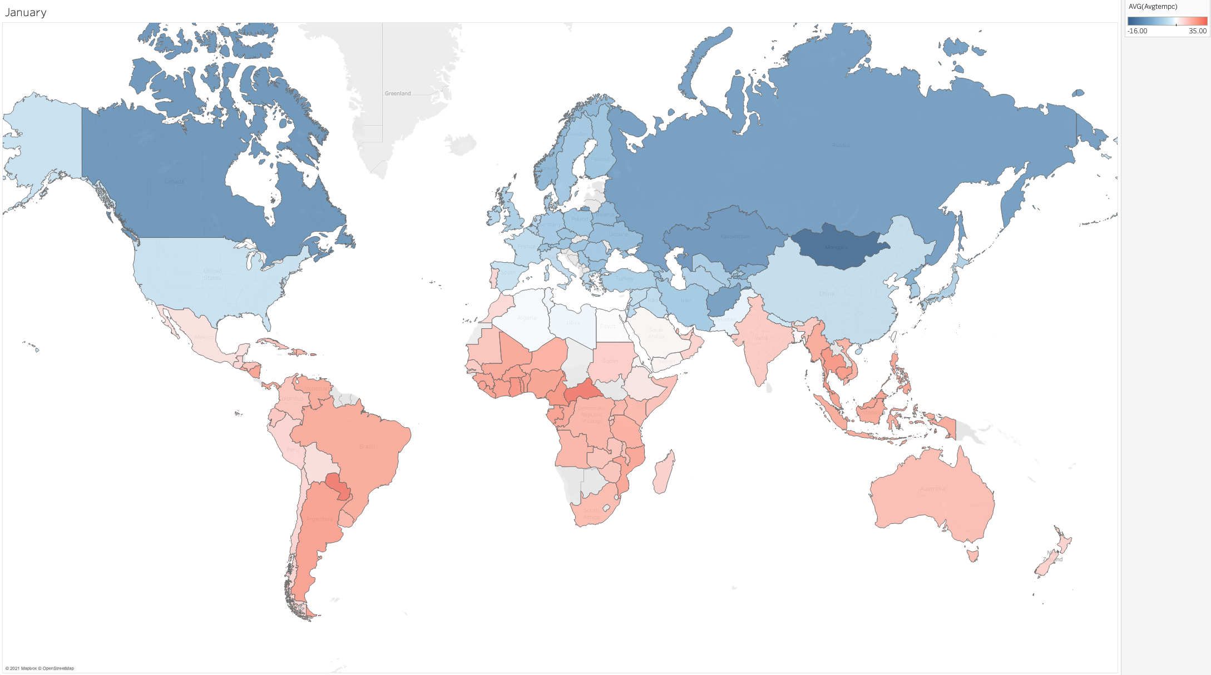
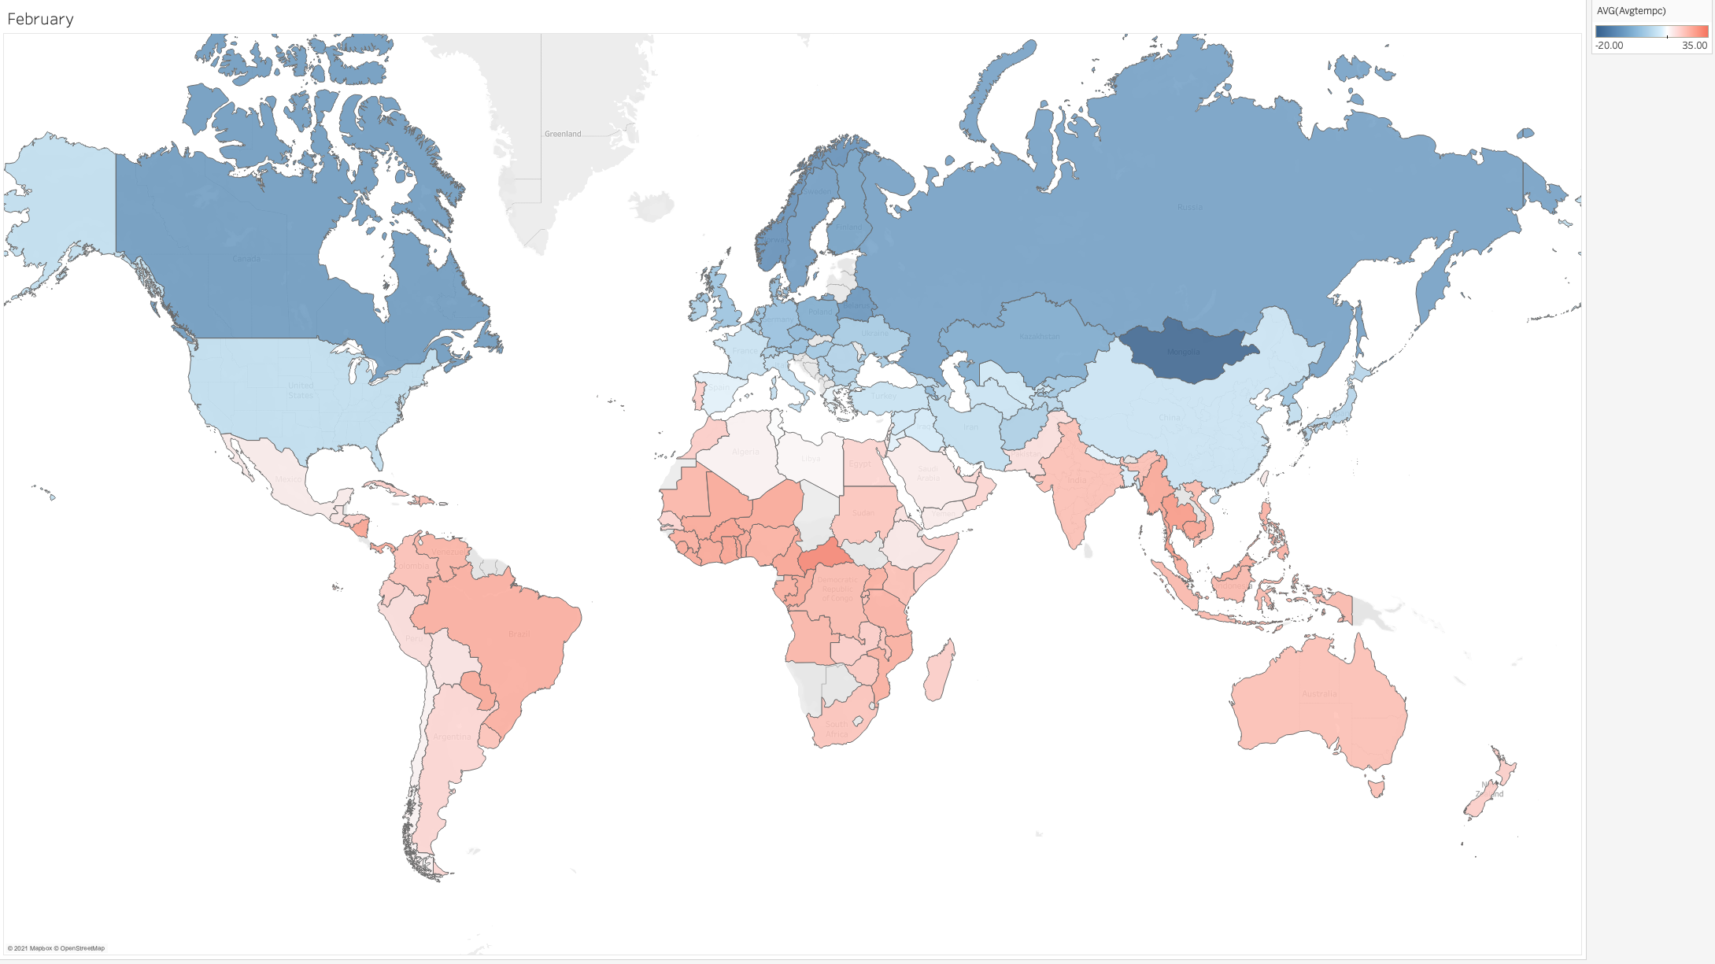
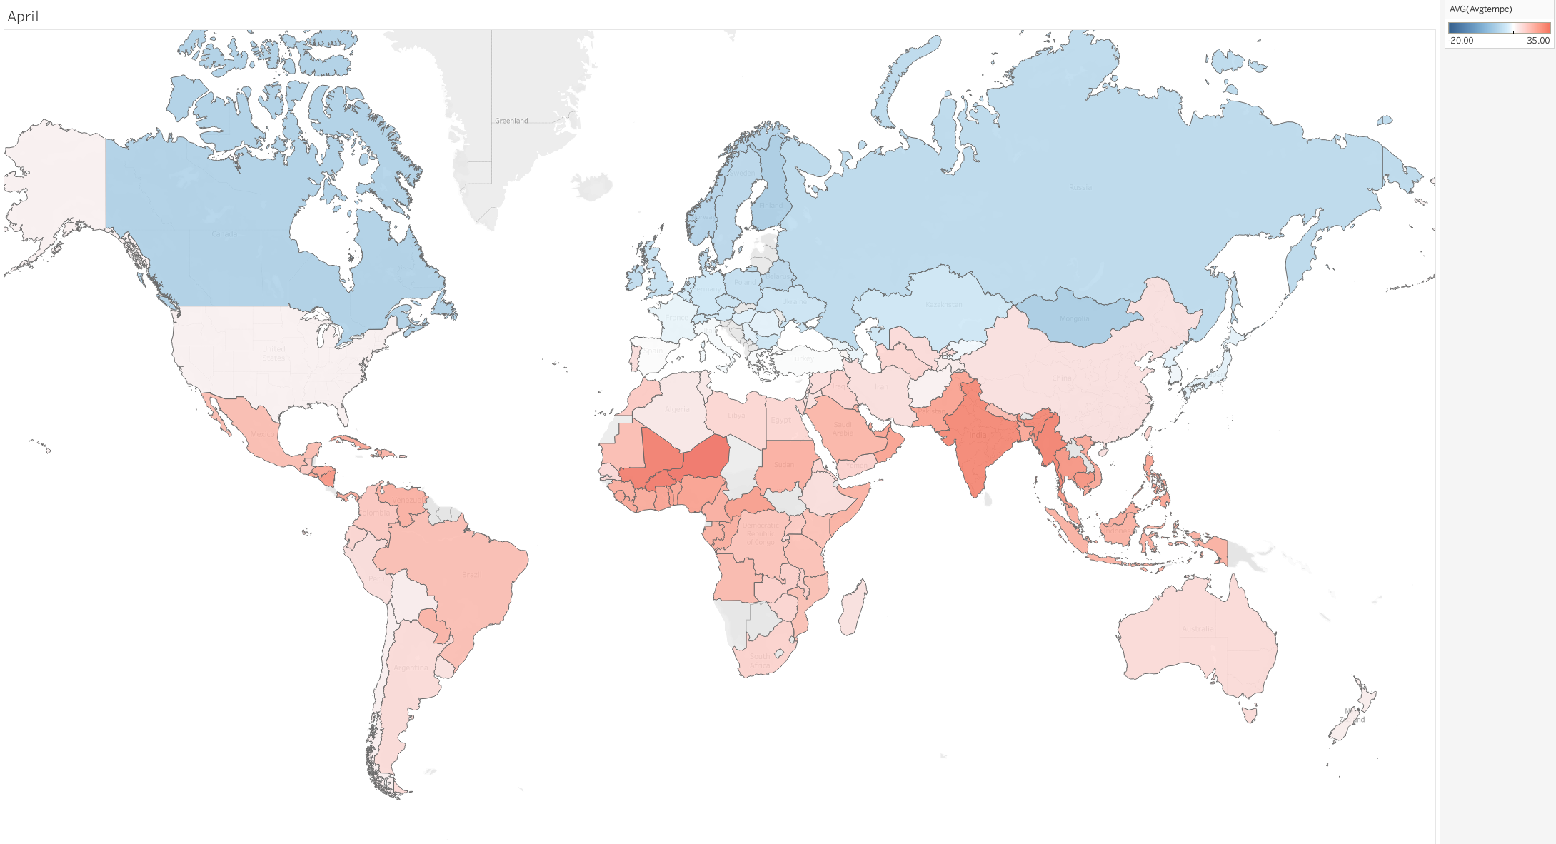
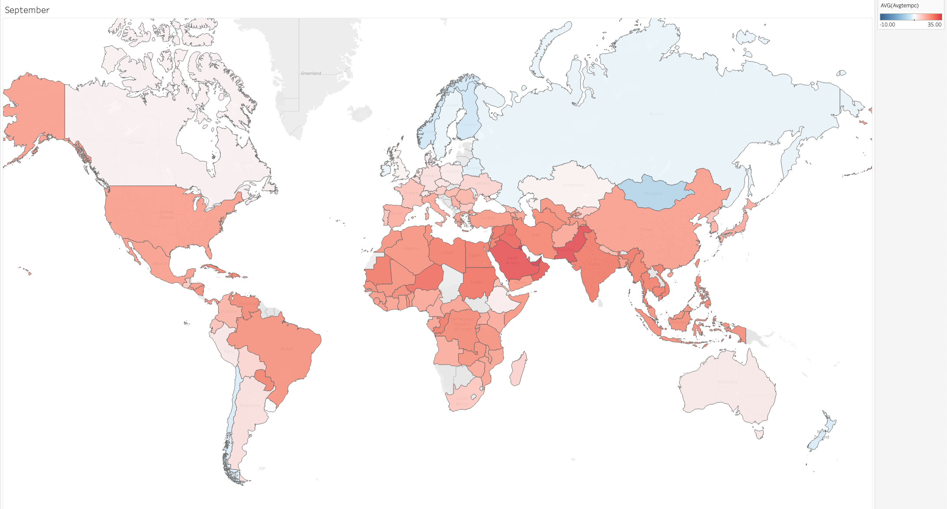
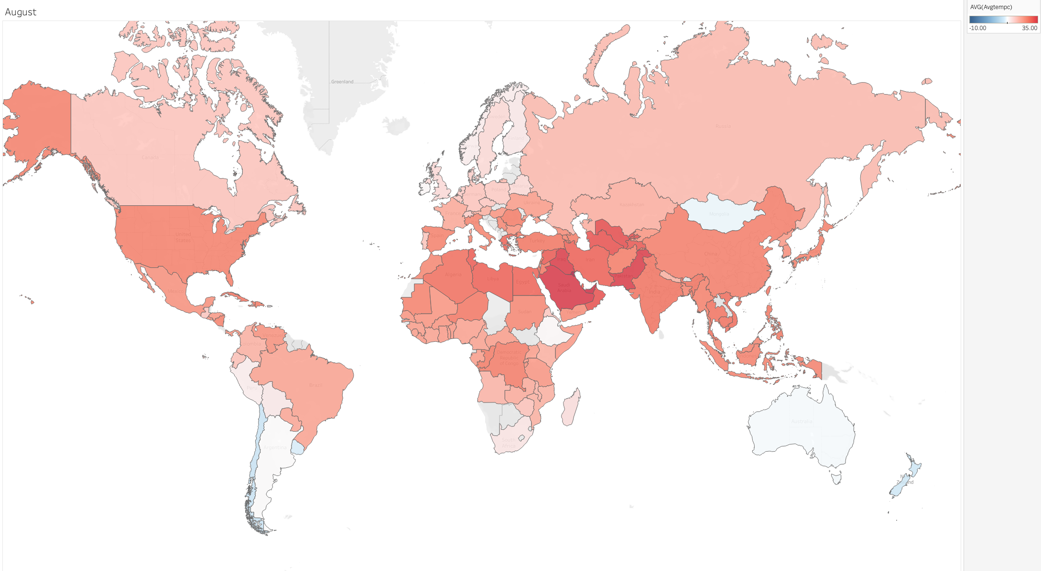
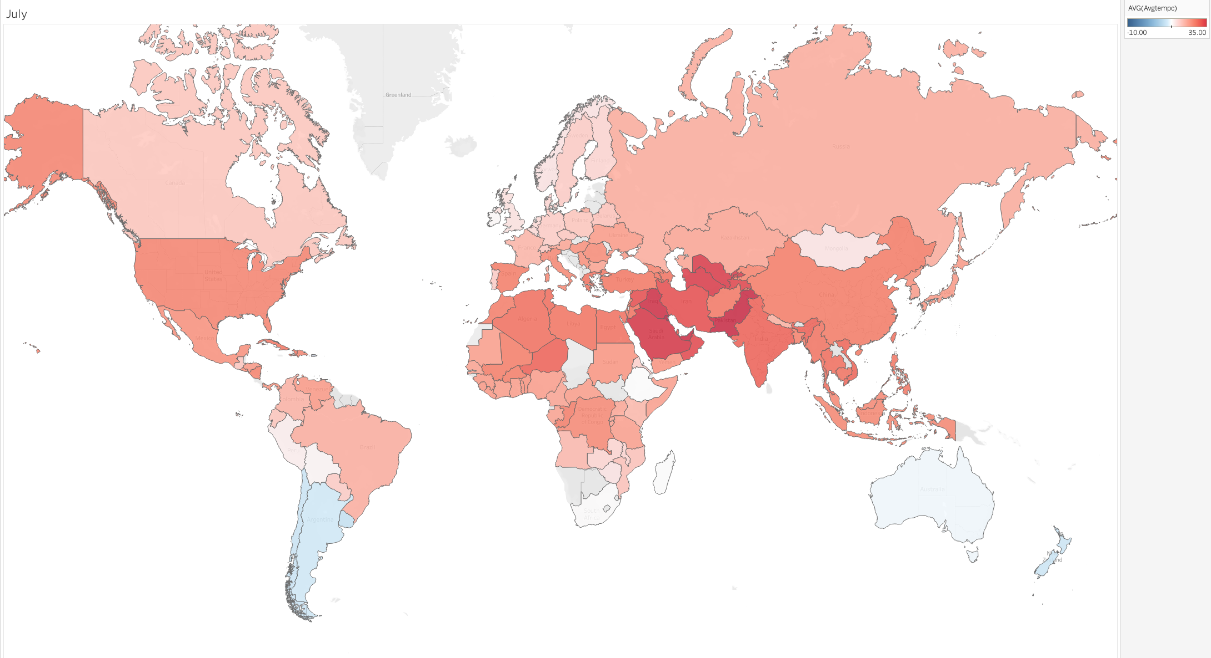
AVERAGE WEATHER MAP
Notes:
Just to see how in the north we have more changes on the clima the on the south

Slide 10
What Is This Travel Advisor?
You fill with one city that you like or visit before
A month that the weather is good in this place
You receive 5 good choices
Put where you are now
Receive flights prices

Slide 11
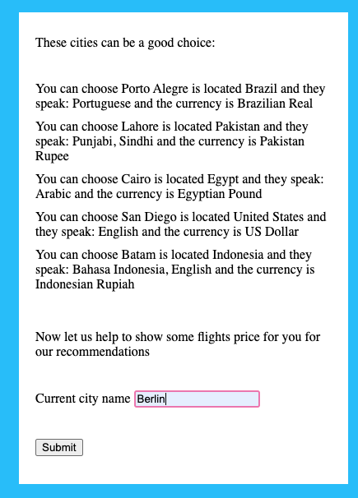
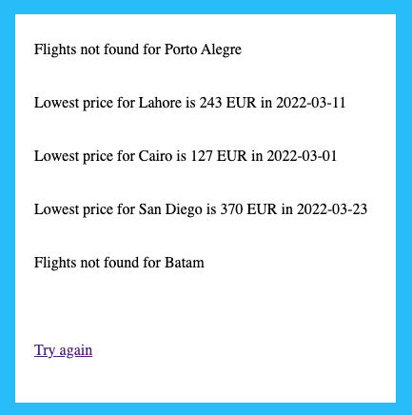
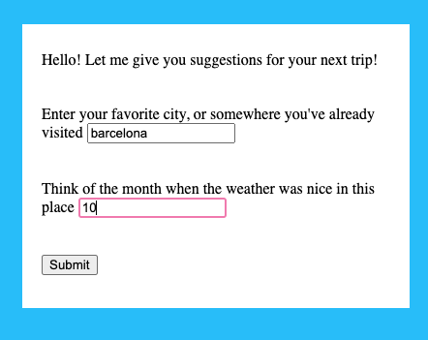
Process
Suggestions
Choices
01
02
03
04
City and Month
City that you live

Slide 12

Thank You!

